Slide 1
Terminology Server by John Snow Labs
Advanced Medical Code Mapping

Slide 2
Contents
What is Terminology Server
Why the terminology server was built
On-Prem Deployment – How it works
Key Capabilities of terminology service
Unified Coding across Vocabularies
Search capabilities of TS

Slide 3
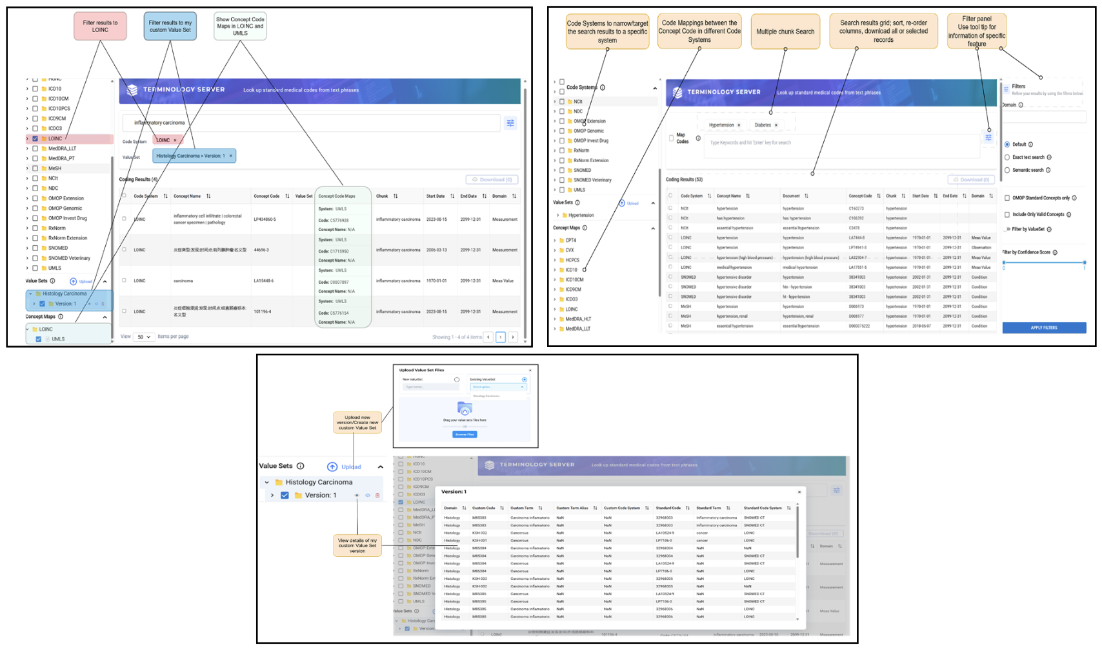
WHAT IS TERMINOLOGY SERVER?
A specialized search engine for medical terminology
Converts clinical text into standardized medical codes
Designed specifically for healthcare data workflows

Slide 4
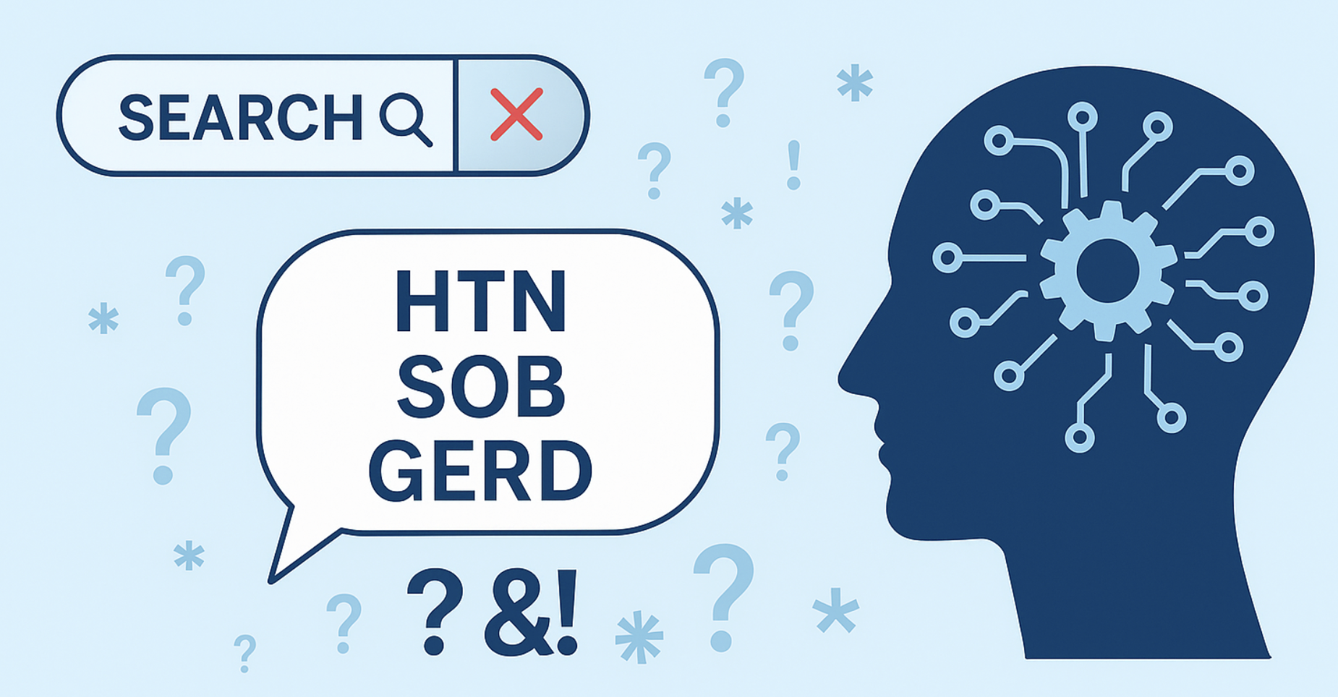
Why Terminology Server was built ?
Traditional coding tools rely on exact matches
Clinical language is messy — abbreviations, typos, variations
Needed a smarter, context-aware search system

Slide 5
On-Premises Deployment — How It Works
Can run entirely inside your secure environment
Installation via one-command script with license
Web UI and API available immediately after setup

Slide 6
Key Capabilities — High-Level Overview
Understands both exact and fuzzy clinical phrasing
Supports multiple vocabularies in a single search
Can filter and constrain by domain, code system, or validity etc.

Slide 7
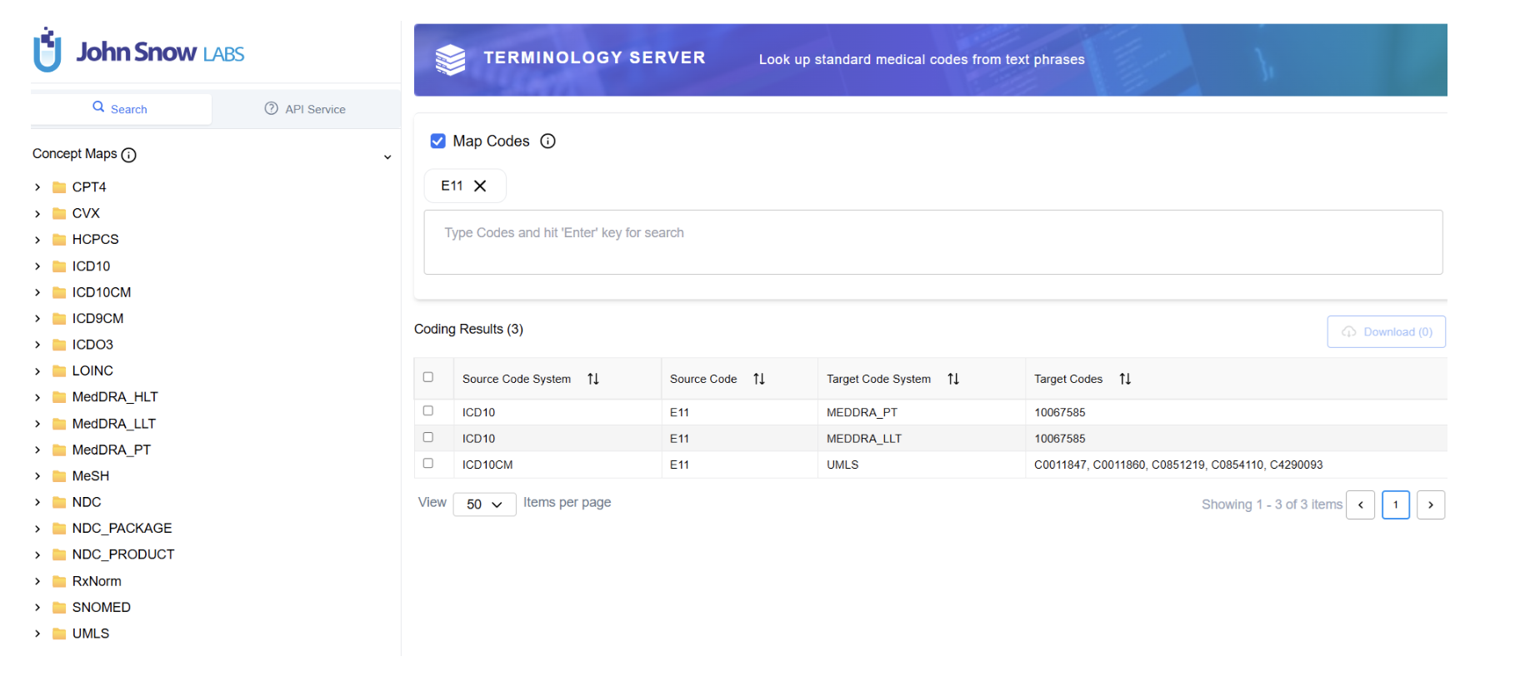
Unified Coding Across Vocabularies with Concept Mapping
Supports all major clinical coding systems including ICD, SNOMED CT, RxNorm, LOINC, CPT, UMLS, and MeSH
Curated concept maps show exact and approximate code relationships between different systems
Interactive visual explorer lets you see how a concept translates across vocabularies in real time

Slide 8
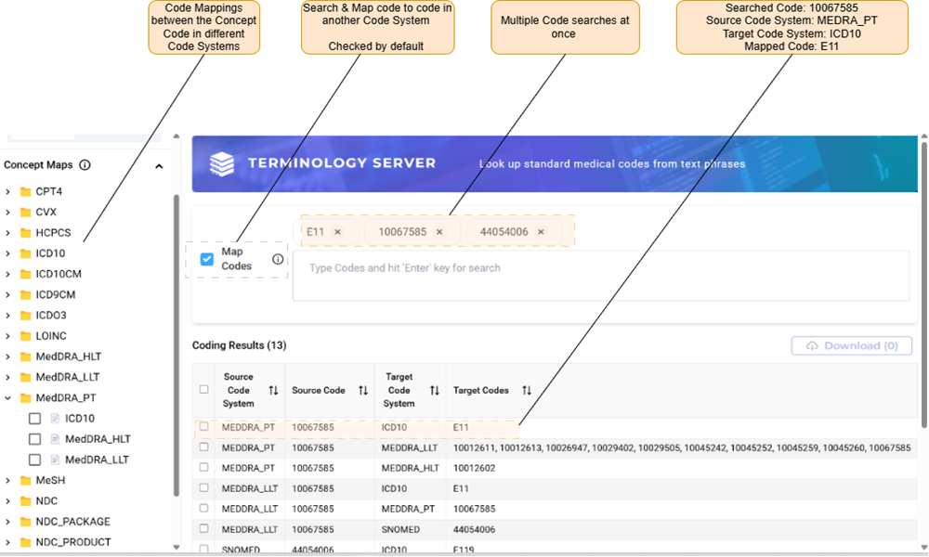
Powerful Search Capabilities of the Terminology Server
Enter a medical code and retrieve its equivalent codes across vocabularies like SNOMED, RxNorm, and UMLS
Search with clinical phrases using both exact and semantic matching, even if there are typos or synonyms
Use Boolean logic, clinical domain filters, and context tags to narrow and prioritize search results

Slide 9
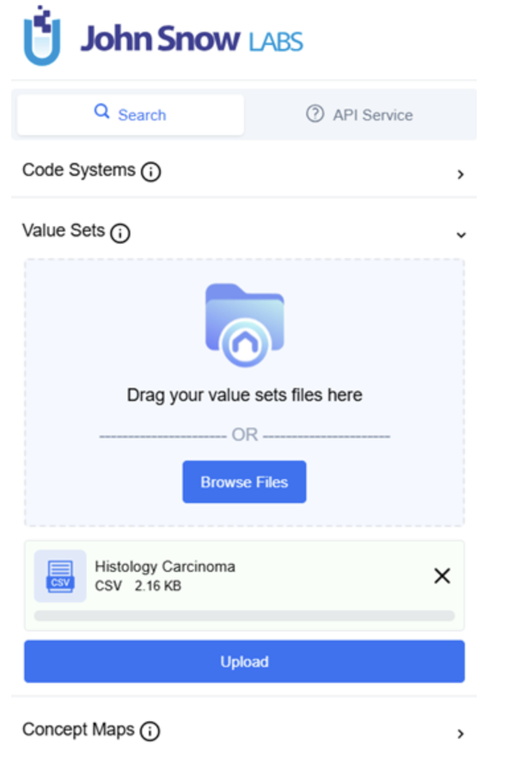
Custom Value Sets for Flexible, Domain-Specific Filtering
Build and upload custom lists of codes grouped by clinical theme, task, or specialty
Use value sets as filters to restrict search results to relevant concepts only
Track versions and changes to value sets over time for governance and reproducibility

Slide 10
TS vs OpenAI LLMs (Strategic Comparison)
TS delivers deterministic, code-backed outputs; LLMs generate variable responses without guaranteed terminology accuracy
TS offers fixed licensing, on-prem deployment, and full privacy control; LLMs are cloud-only and metered per usage
TS provides UI + API with native support for concept hierarchies and value sets; LLMs offer only API access with no terminology model
TS excels at precise term-level mapping; LLMs excel at document-level inference and abstraction
TS stays continuously aligned with official vocabulary updates; LLM knowledge is static and may lag behind

